Slide 1
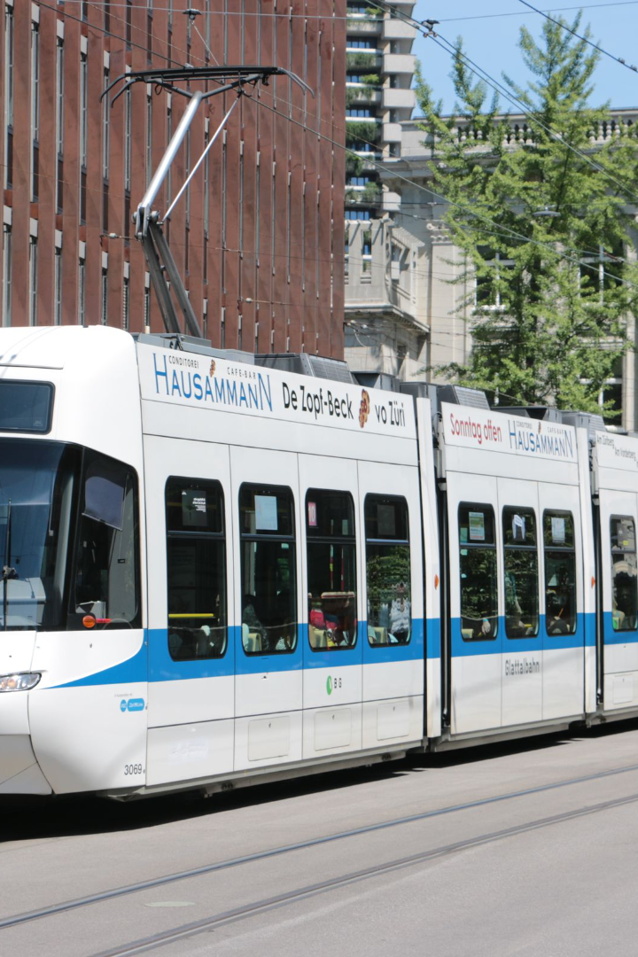
Public Transportation Efficiency Analysis
Welcome to this project where we aim to assess the efficiency, on time performance, and passenger feedback of public transportation. By analysing this data, we strive to support transportation improvement initiatives and enhance the overall public transportation experience.

Slide 2

Analysis Objectives
1
On-Time Performance 🚏
2
Efficiency 💪
Identify objectives for analyzing the efficiency of public transportation services.
Define specific objectives for analyzing public transportation data such as assessing on-time performance.
3
Passenger Satisfaction 😀
Assess passenger satisfaction through data analysis.

Slide 3
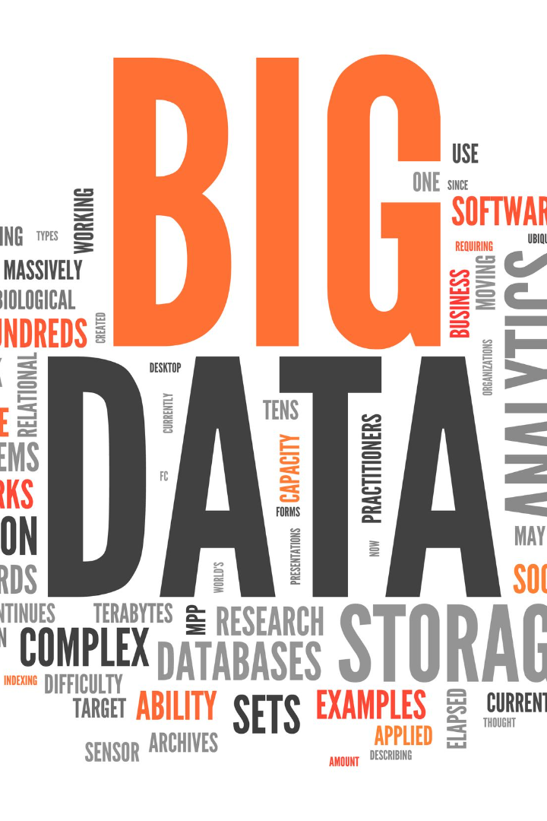
Data Collection
In order to analyze public transportation data, we need to identify trustworthy sources and methods for collecting transportation data. These sources could include schedules, real-time updates, and passenger feedback.

Slide 4
Code Integration
Data Cleaning ✨
Data Transformation 🔄
Statistical Analysis 📊
Clean the data to ensure accurate, unbiased analysis results.
Transform the data into a more useful format for further analysis.
Use code to perform statistical analysis and discover meaningful
insights.

Slide 5
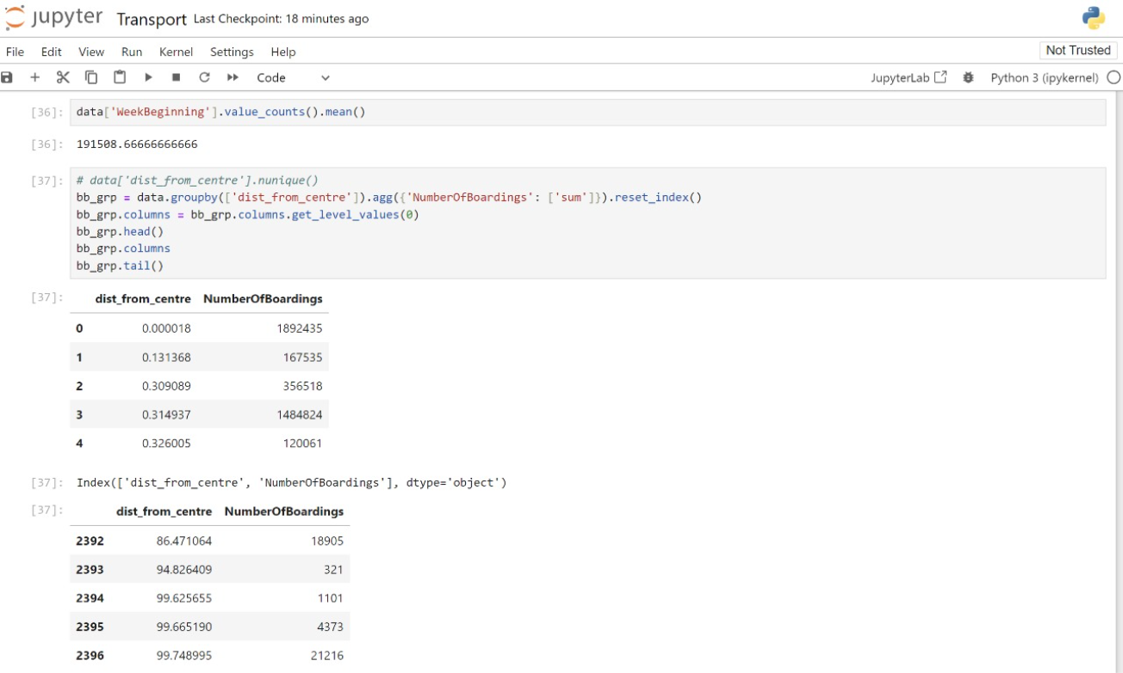

Slide 6
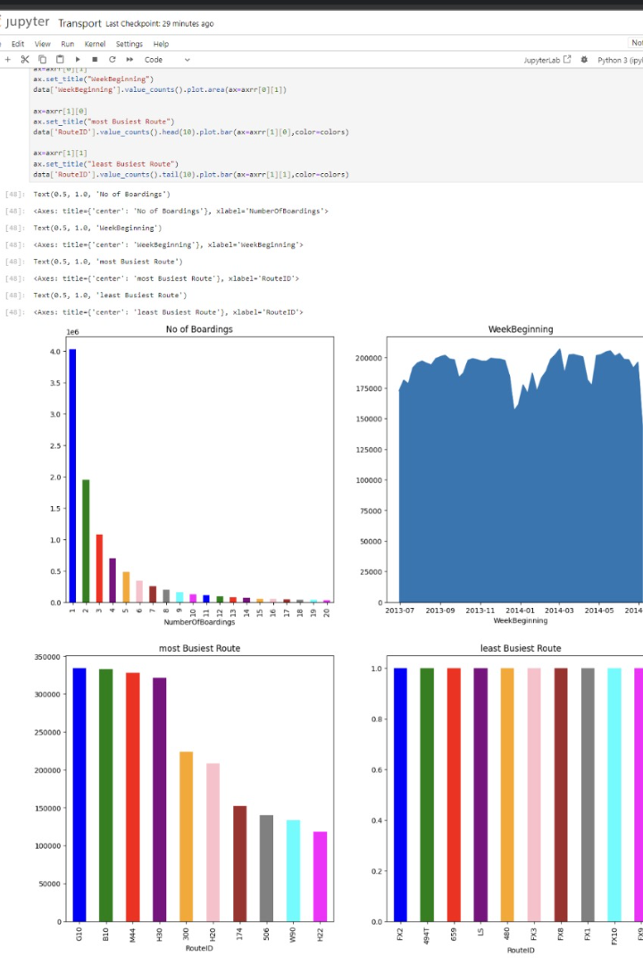
Visualization Strategy
To effectively communicate insights from our analysis, we need a plan for visualizing the data. IBM Cognos is an excellent tool for creating informative dashboards and reports.

Slide 7
The Importance of Reliable Public Transportation 🚍
Convenience
Economic Benefits
A reliable public transportation system provides a convenient travel option to passengers who may not have access to personal vehicles.
Reliable public transportation reduces traffic congestion, air pollution, and demand for expensive parking space, benefiting both the environment and the economy.

Slide 8
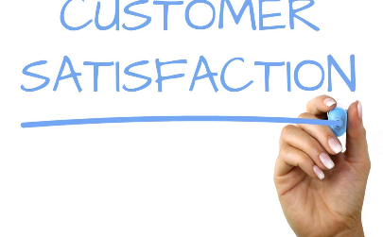

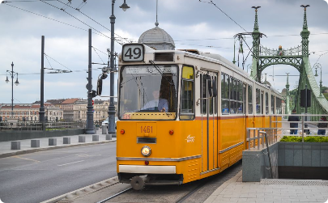
Customer Feedback
Passenger Surveys 📝
Social Media Listening 🎧
Positive Reinforcement 🌟
Use surveys to collect feedback from passengers to improve customer satisfaction.
Monitor social media to quickly identify and address passenger concerns.
Recognize and incentivize good performance by public transportation operators.

Slide 9
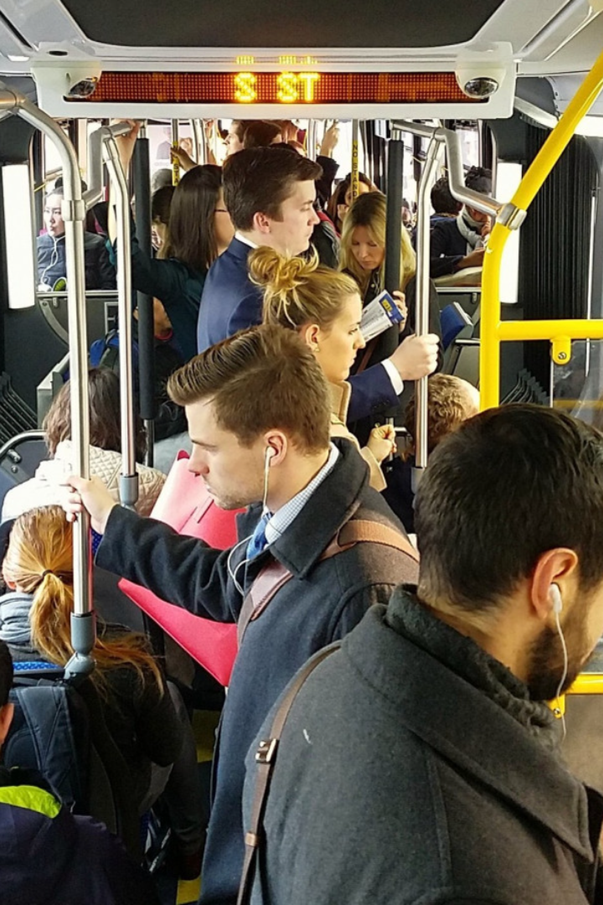
The Search for Improved Public Transportation 🕵️‍♂️
Through our analysis of public transportation data, we hope to provide insights that support transportation innovation and create a better commuting experience for everyone.

Slide 10
Basic Idea [Flowchart]
1
Data Collection
Collect reliable transportation data from various sources.
Pre-Processing
2
Clean, transform, and prepare the data for analysis.
3
Data Analysis
Use code to perform statistical analysis and discover meaningful insights.
Data Visualization
4
Use IBM Cognos to create informative visualizations and reporting.

Slide 11

The Future of Public Transportation 🚆
1
Sustainable Transportation 🌍
2
Technological Advancements 🚀
3
Organizational Development 🏢
Public transportation is an essential part of sustainable urban mobility, and it will continue to play a crucial role in the future.
New technologies, such as autonomous vehicles and smart transportation systems, will likely revolutionize public transportation.
As the world becomes more urbanized, public transportation systems will need to keep up with increased demand.

Slide 12
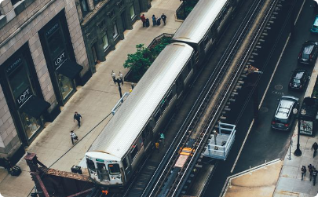
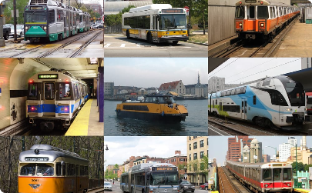
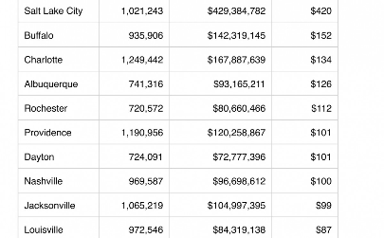
Public Transportation Investment 💰
Infrastructure
Electric Buses
Government Funding
Investments in public transportation infrastructure, such as new rail lines, bus routes, and transit hubs, can significantly enhance the overall commuting experience.
Investing in electric buses and other environmentally friendly modes of transportation can reduce air pollution and improve the quality of life for commuters.
Public transportation systems often rely on funding from the government to provide reliable and affordable services to passengers.

Slide 13

Conclusion
Through the analysis of public transportation data, we can identify areas that require improvement and support transport improvement initiatives. Effective data visualisation strategies and code integration will simplify complex transportation data analysis and provide actionable insights for public transportation improvement.

